Slide 1

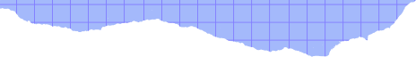








The team
Final Project
IOTDF
Simba
Timon
Pumbaa
林芷伃
group name: Hakuna Matata
members name: B103011004 林芷伃
B103011050 黃郁珊
B103015006 胡庭翊
黃郁珊
胡庭翊

Slide 2



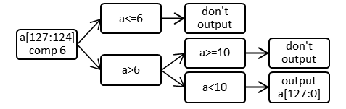
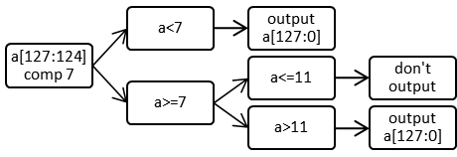
Algorithm - Avg
Algorithm - Extract & Exclude
Algorithm - (Peak) Max & Min
8 input data
SUM
128 bits for a complete input data
(16 clk cycles )
128 bits shift left 3 bits
(128 *8 data)
Extract:
compare the first 8 bits(close to MSB) of two input data(each 128 bits)
Compare every 8 bits starting from the MSB ends of the two data.
MIN
MAX
up to 131 bits
Exclude:
1 round
Maximum and minimum values ​​are selected through MUX and output to another register.
131 shift right 3 bits
When A>B or B>A, a positive edge trigger will be generated at the input port of D Flip-flop.
Average
SUM / 8 data
128 bits
Peak
MINMAX
2 round

Slide 3

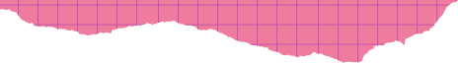
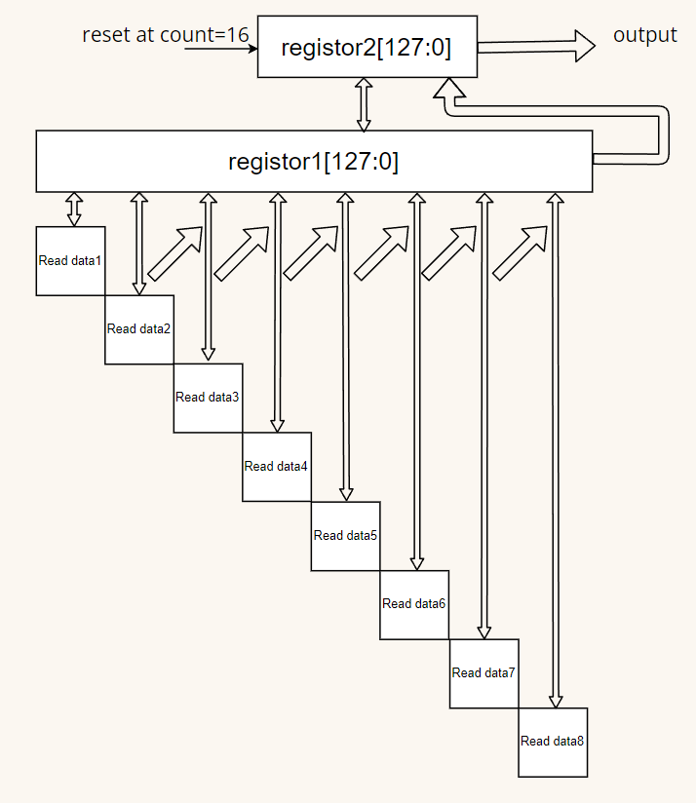
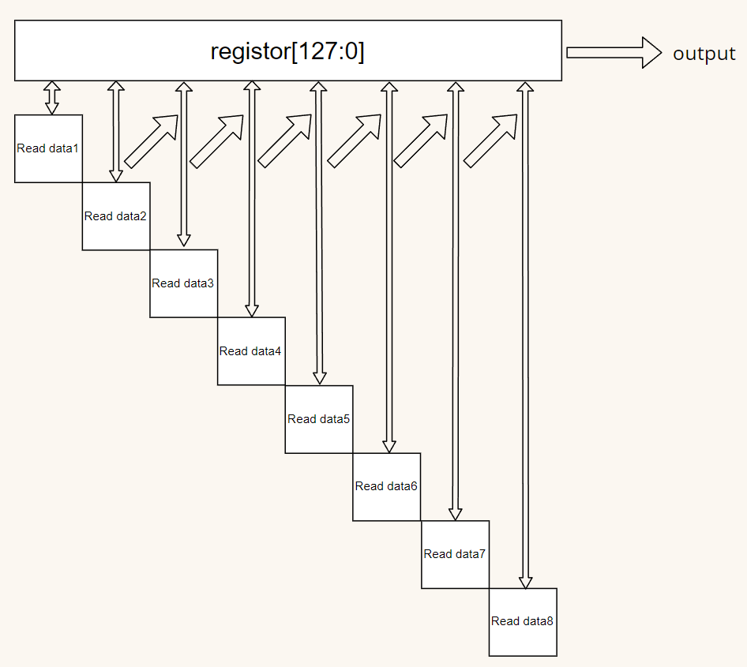
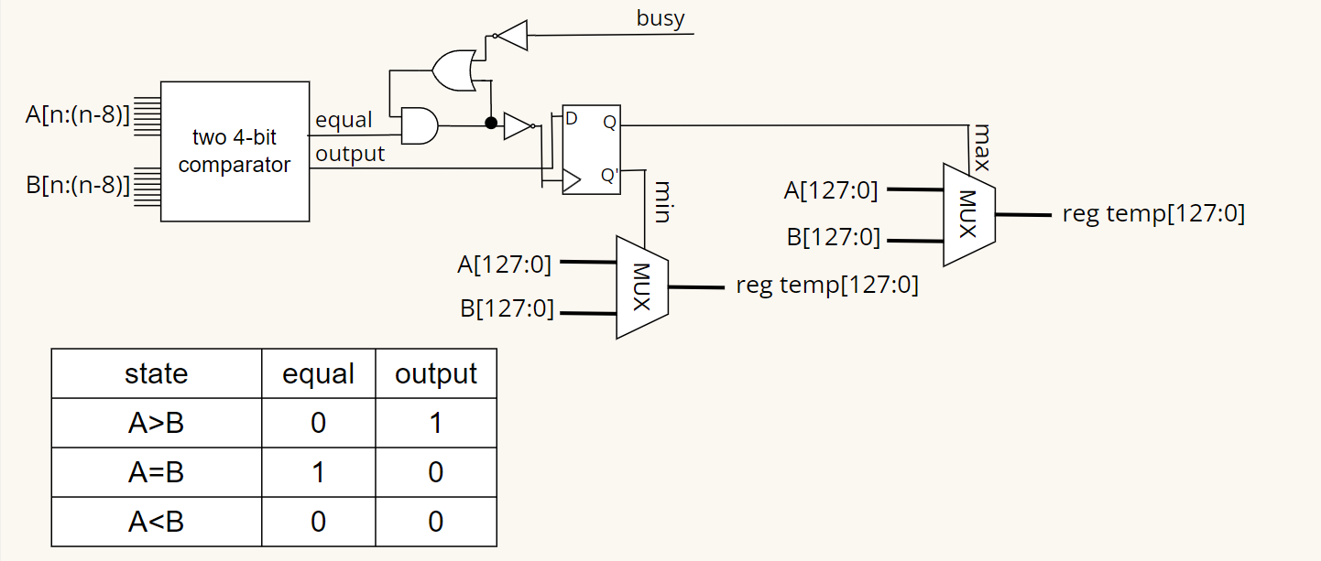
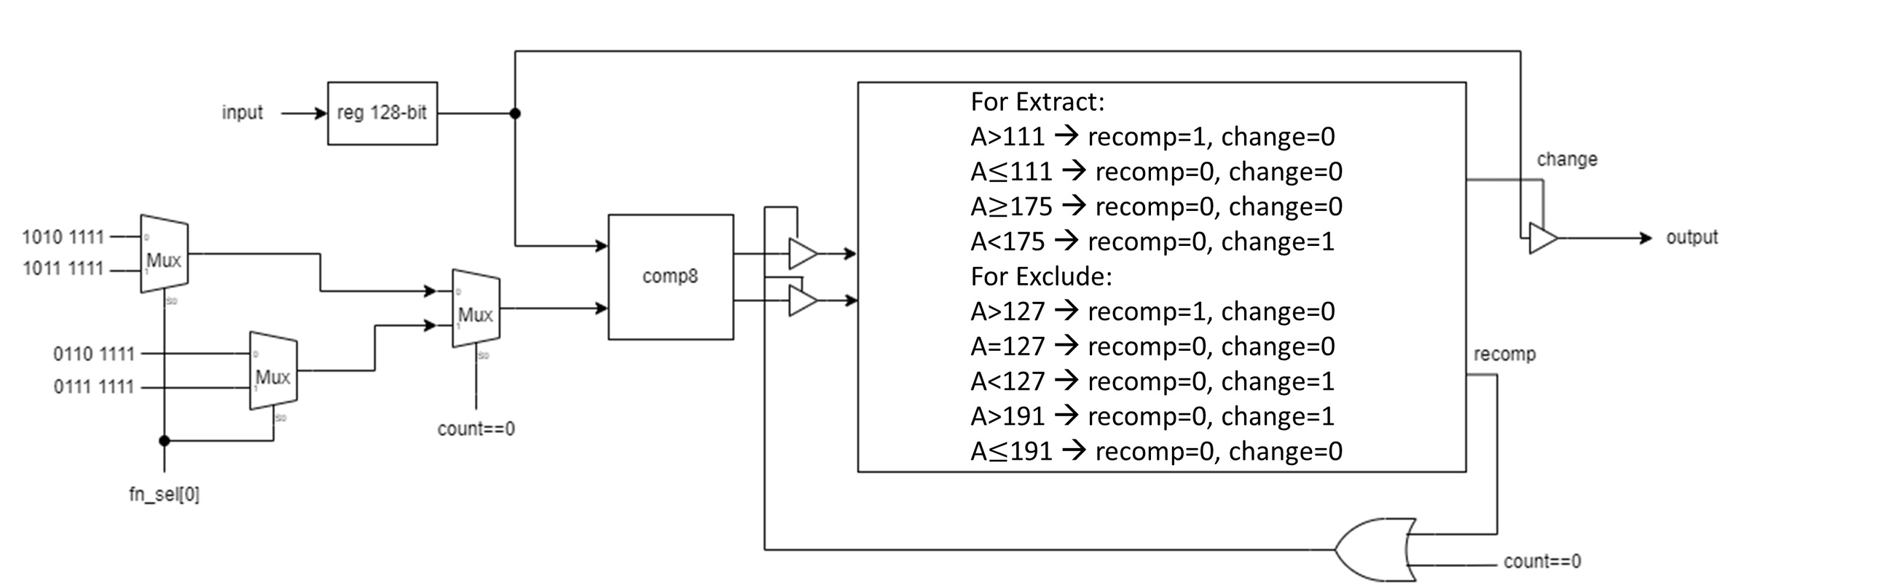
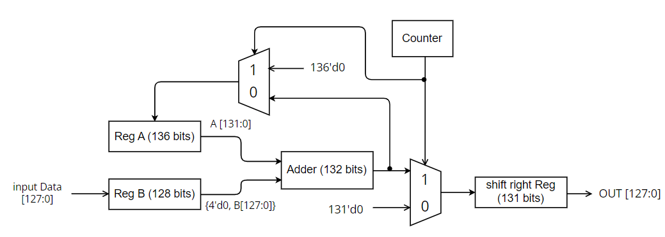
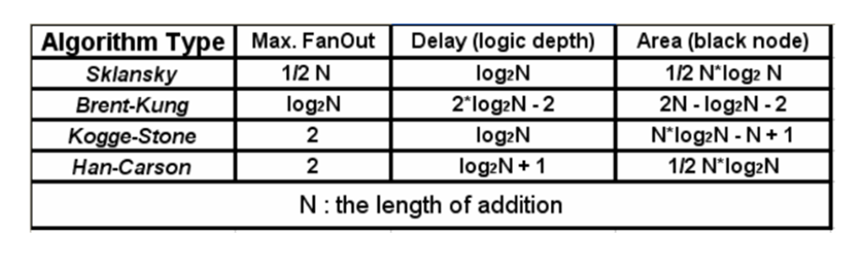
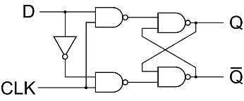
Structure - Max & Min
Structure - PeakMax & PeakMin
Structure - Extract & Exclude
Structure - Avg
Structure - Max & Min
132-bits Adder
--> 8*16bits Brent-Kung Adder+4bits Full Adder(MSB)
Cycle
count
store
Cycle
Brent-Kung Adder is one of a parallel prefix adder(PPA).
PPA are the fastest adders with tree structure based.
this adder exists the minimum area.
1~16
the stored value will be compared in next stage
1~16
compare
17~32
17~32
output max or min according to the select
33~48
33~48
49~64
49~64
Structure of DFF
...
...
one data is 128 bits => the maximum bit number of the sum of this 8 data(one round) is 131 bits

Slide 4



Known
&
to-be learn issue
waste of storage space: 128-bit registers & 136-bit register
large number of clock cycles:
target: smaller area --> execute time will become larger

Slide 5







Member job assignment
watch all groups’ video and create final structure
first edition code
run synthesis
final code
optimize circuit
final report
林芷伃
黃郁珊
胡庭翊
TO-DO LIST
final structure
final structure
final structure
extract/exclude
avg
run synthesis
complete code v1
(peak) max/min
report v1
testbench simulation
testbench simulation
testbench simulation
optimize circuit
optimize circuit
optimize circuit
final papper
final papper
final papper

Slide 6
Project work schedule
Week 1 (12/11-12/17)
Week 2 (12/18-12/24)
Week 3 (12/25-12/31)
Week 4 (1/1-1/7)
structure v1
final structure
(peak) max/min
avg
extract/exclude
complete code v1
run synthesis
report v1
presentation
optimize circuit
final papper
final papper submit

Slide 7
Possible issue & expected solution
Possible issue & expected solution
If input A = B then the value of “equal” will always be 0 and this causes the signal input to D Flip-flop always be 1 → can’t generate any positive edge signal to trigger D Flip-flop to output value D
solution: use a counter with a smaller period of clock cycle (compare to input clk signal) to initialize the value to 0 which needed to input to D Flip-flop
2. the output is not what we expected
→ write each function in sub-module and compile each of them to debug
THANK
YOU!
0->1
1->0
count
0
0
0 or 1
0 or 1
1
1 or 0

